Slide 1

NEAR FIELD COMMUNICATION
Presented By:
B.E Comps
Sagar G. Mitna (16)
Pradeep U. Kamble (09)
Shanawaz S. Jaliyawala (06)

Slide 2
ABSTRACT
For making the day to day life more convenient for the passengers travelling in bus some technologies can be used like Near Field Communication (NFC), The proposed system is based on ticketing and identification of passengers in public transport. The system suggest a user friendly automated ticketing system which will automatically deduct the passengers fare according to the distance travelled as well as detect the passengers detail information. The system also helps to calculate the total revenue of a single bus in a day. Another important aspect is reusability, which helps use ticket multiple times as it is rechargeable.

Slide 3
WHAT IS NFC???
NFC or Near Field Communication is a short range high frequency wireless communication technology.
A radio communication is established by touching the two phones or keeping them in a proximity of a few centimeters.
NFC is mainly aimed for mobile or handheld devices.
NFC is an extension of Radio frequency identification or RFID technology.
RFID is mainly used for tracking and identification by sending radio waves.

Slide 4
NFC BASED MOBILE TICKETING SYSTEM
This proposed projects aims to develop a user friendly, interactive automated ticketing system which will deduct the passengers fare according to the distance travelled as well as detect the passengers identification.
This is only possible by use of Near Field Communication (NFC) Cards.

Slide 5
Existing System
In current system conductor manually cut the ticket of a passenger.
When passenger enter into the bus he pays a ticket amount and specify the source and destination, then conductor cut the ticket and return back to passenger.
This system contains manual and paper work.
Some time change issue also get create. Passenger and conductor both don’t have change for ticket amount which creates issue.
To solve those problems we are developing a new system which is fully automated and paperless.

Slide 6
Proposed System
As soon as the bus arrives at the bus stop, the passenger would board the bus and show the tag to the Conductor.
The Conductor in the bus will read the NFC tag using android based NFC reader.
NFC based card that will have a unique ID number. The card is rechargeable from certain electronic booths placed at certain locations of the city.
The reader will detect the tag and require certain information from the passenger.

Slide 7
Literature Survey
Sr.no | TOPIC NAME | INVENTORS | PROPOSED WORK
1 | Analyzing the problem of Passenger’s self-hold ticket and physical form of ticket | Surya Michrandi Nasution1, Emir Mauludi Husni, Aciek Ida Wuryandari | Simplifyingthe ticketing process and transforming ticket from physical form to virtual form. The NFC technology development will not be limited only for payment transaction.
2 | Design and development of a secure e-ticketing scheme for mobile devices. | Arnau vives-guasch, Magdalena payeras-capell, Maci`a mut-puigserver, Jordi castell `a-roca, and Josep llu´is ferrer-gomila. | Protocol presents a fair-trading mechanism during the ticket verification in such a way that user pays in exchange of the right to use the agreed service

Slide 8
Literature Survey
Sr.no | TOPIC NAME | INVENTORS | PROPOSED WORK
3. | Introduction of NFC is integrated within sender’s mobile device as well as in receiver’s mobile device for communication. | M.R.Waghe, P.A.Pawar, Prof S.N. Bhadane. | Communication occurs within two NFC enabled devices when these two devices within the range of twenty centimeters of each other.

Slide 9
Hardware Requirement
NFC based Android Mobile
NFC Tags
Intel processor IV and above
1 GB RAM
160 GB hard disk

Slide 10
Software Requirement
Visual Studio 2010
MS SQL Server 2005
SDK for Android 4.2
Windows XP
Windows Vista
Windows 7/8/8.1Pro/10

Slide 11
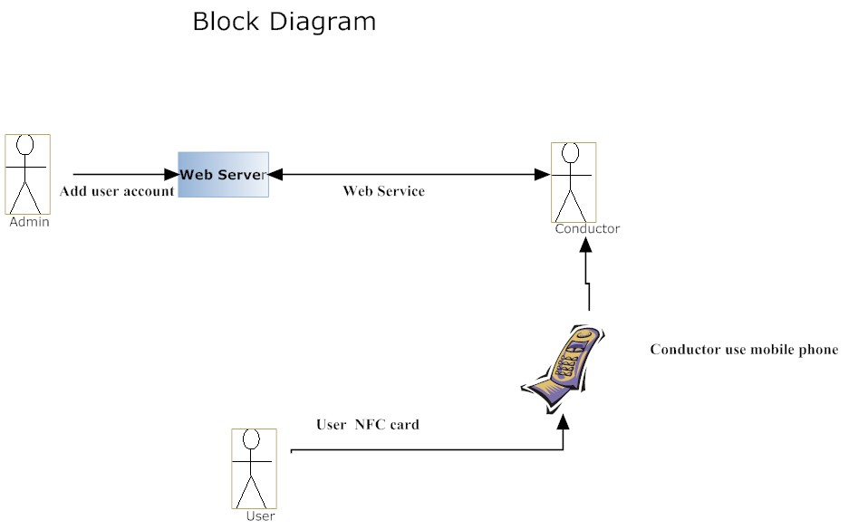
Proposed Architecture

Slide 12
Proposed Architecture

Slide 13
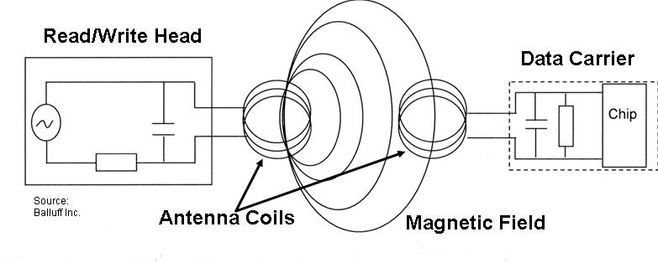
OPERATION OF NFC
Near field communication is based on inductive-coupling.
NFC works using magnetic induction between two loop antennas located within each other's 'near field’.

Slide 14
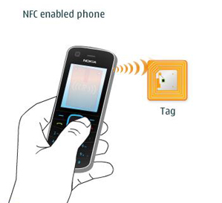
OPERATION OF NFC
operating frequency 13.56 MHz.data rate 106 kbit/s to 424 kbit/s.
NFC use an initiator and a target; the initiator actively generates an RF field that can power a passive target.
Initiator
Device
Target

Slide 15
OPERATION OF NFC BASED MOBILE TICKETING SYSTEM
NFC tags is going to be used in this project.
Passenger would carry NFC card with them, when they enter to the bus they have to show the NFC card to the conductor.
The conductor will use NFC based on the distance travelled the cost would be automatically deducted.

Slide 16
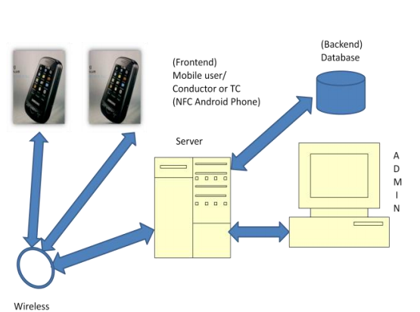
OPERATION OF NFC BASED MOBILE TICKETING SYSTEM

Slide 17
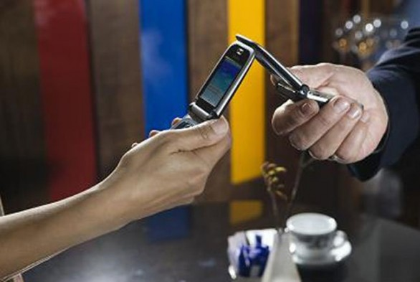
MODES OF OPERATION
In Active mode, both devices with NFC chip generates an electromagnetic field and exchange data.
Two NFC enabled devices transfer-ring data in active mode

Slide 18

MODES OF OPERATION
In Passive mode, there is only one active device and the other uses that field to exchange information.
A NFC-enabled mobile phone is paired with a RFID-tagged "smart poster"

Slide 19
APPLICATION OF NFC
NFC applications can be split into the following three basic categories:
Touch and Go
Touch and Confirm
Touch and Connect

Slide 20
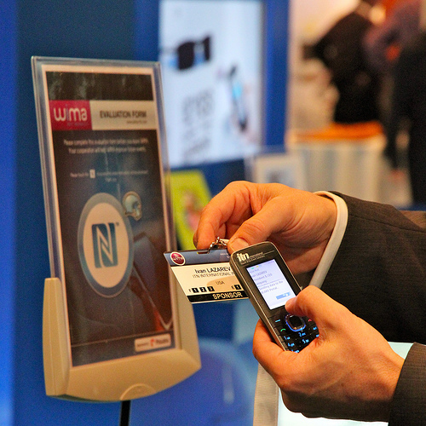
APPLICATION OF NFC
Touch and Go
Applications such as access control or transport/event ticketing, where the user needs only to bring the device storing the ticket or access code close to the reader. Example for picking up an Internet URL from a smart label on a poster.
Touch and go
Mode of application

Slide 21
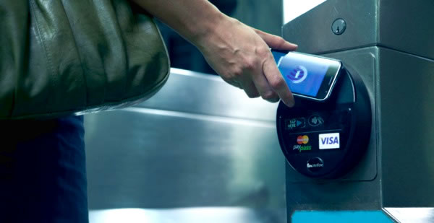
APPLICATION OF NFC
Touch and Confirm
Applications such as mobile payment where the user has to confirm the interaction by entering a password or just accepting the transaction.

Slide 22
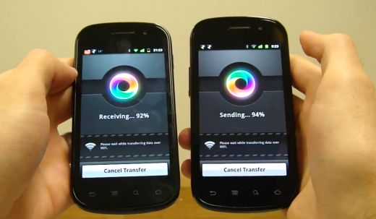
APPLICATION OF NFC
Touch and Connect
Linking two NFC-enabled devices to enable peer to peer transfer of data such as downloading music, exchanging images or synchronizing address books.
Data transfer via NFC

Slide 23
ADVANTAGES OF NFC BASED MOBILE TICKETING SYSTEM
It has user friendly interface.
Better passenger convenience.
Less cash handling.
Auto accounting.
Flexible source and destination.
No use of papers
Useful data, real time information and pricing

Slide 24
DISADVANTAGES OF NFC BASED MOBILE TICKETING SYSTEM
The system has the limitation that it can be operated only with devices under a short range i.e around 10 cm.
The data transfer rate is very less at about 106kbps, 212 kbps and 424kbps.

Slide 25
CONCLUSION
Human efforts are reduced because system is completely automated and efficient. The cards being reusable, they are much more convenient and eco-friendly compared to the existing ticketing system. The record of the entire expense of the bus can be provided by the bill printer. Any unwanted things can be avoided as all the person carrying NFC tickets are monitored every time they travel.

Slide 26
REFERENCE
http://www.nfc-forum.org
http://www.gemalto.com/nfc.html
http://www. whatis.techtarget.com/nfc.html
http://www. asia.cnet.com/near field communication.html
www.radio-electronics.com/info/wireless/nfc/nfc_overview.php
http://www.controleng.com/index.asp?layout=article&
articleid=CA6289218&spacedesc=latest News
http://www.nxp.com/news/content/file_1053.html

Slide 27
THANK YOU
☺
SAGAR MITNA 16
PRADIP KAMBLE 09
SHAHNAWAZ JALIYAWALA 06

